Slide 1
Research at TULIP Lab
Gang Li
School of Information Technology
Deakin University, Australia

Slide 2
Outline
TULIP Lab
Who?
What?
How?
Research at TULIP
Training at TULIP
Rules in TULIP

Slide 3
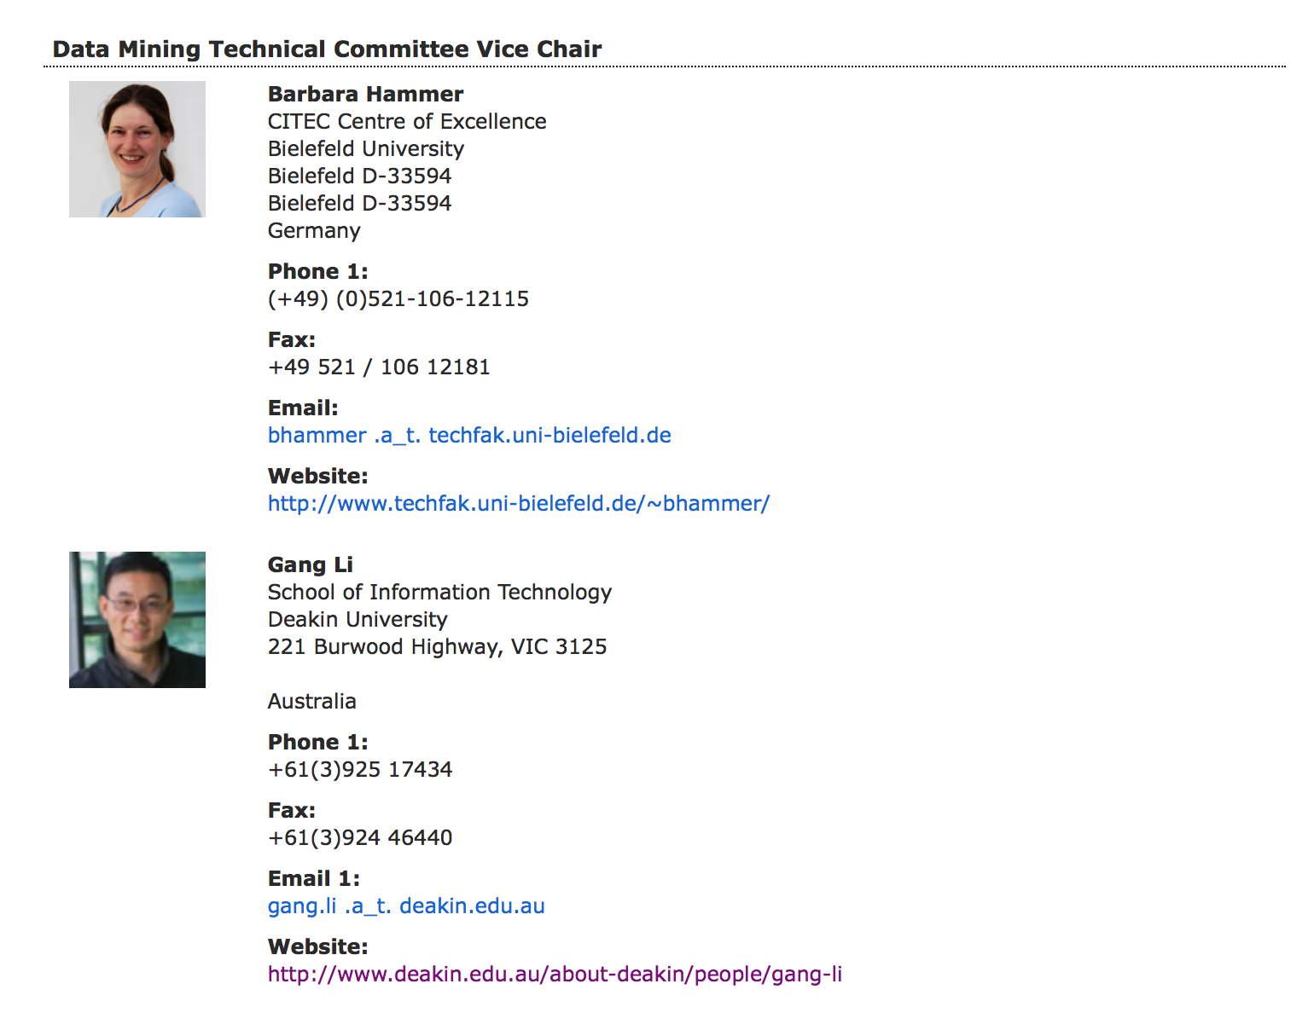
TULIP Team (http://www.tulip.org.au)
A/Prof. Gang Li
IEEE Technical Committee
IEEE Task Force on EDM (Vice chair)
Data Mining and Big Data Analytics (Vice Chair 2017)
Enterprise Architecture and Engineering
Enterprise Information Systems
Deakin
University Thesis Examination Committee
SEBE Faculty HDR Director
Current Director for
S578/S678/S778/S779 (Master of Information Technology)
Founding Director for
S306 (Bachelor of Computer Science)
S777 (Master of Data Science)

Slide 4
Deakin rankings
 | Benchmark | 2014-15 | 2015-2016 | 2016-2017 | 2017-2018
QS# | World National Victoria Under 50 | 360 19 4 50 | 324 | 355 | 293
THE | World National Victoria | 325 13 3 | 301-350 | 251-300 | 301 17
THE<50 | World National Victoria | 59 7 1 |  |  | 43 8
ARWU | World | 401-500 19 4 | 301-400 | 201-300 | 201 11
CWTS Leiden | World National Victoria | 284 11 3 | 325 17 | 314 17 | 226 11

Slide 5
TULIP Lab (http://www.tulip.org.au)
Homepage : http://www.tulip.org.au
Twitter: tulipacademy
Weibo: https://weibo.com/tulipacademy
Github: https://github.com/tulip-lab
Tulip Calendar:
https://calendar.google.com/calendar/embed?src=1trnk46p4gae8ev410ku57sba4%40group.calendar.google.com&ctz=Australia%2FSydney
https://calendar.google.com/calendar/ical/1trnk46p4gae8ev410ku57sba4%40group.calendar.google.com/public/basic.ics

Slide 6
Lab Organization
TULIP Lab
Academy: all members
Headquarter: PhD and Postdoc in Melbourne
Master: master students
Trainee: members to be assessed for research lab entry
FLIP00
FLIP01
...
Visitor: visiting members
Web Team: web site maintaining team, publicity team

Slide 7
Section Breaker

Slide 8
Research at TULIP (Team for Universal Learning and Intelligent Processing)
Current Research Themes@ TULIP Lab
Behavior Informatics
Periodic Behavior Mining
Behavior Prediction
Information Abuse Prevention
Data Compliance Checking
Privacy Preservation in Data Mining
Business Intelligence Applications
Recommender System
Tourism/Hospitality Management

Slide 9
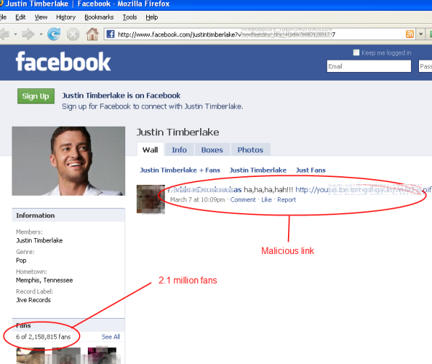




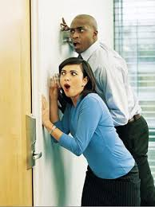

Theme 1. Behavior Informatics
People share news, interests and ideas in OSNs,
though these platforms also spread email malware, rumours, gossips and malicious links, and also leak our privacy.

Slide 10
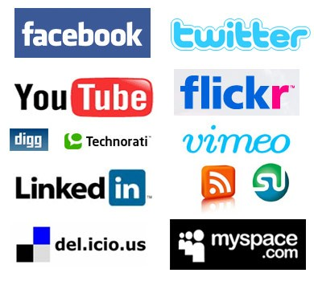
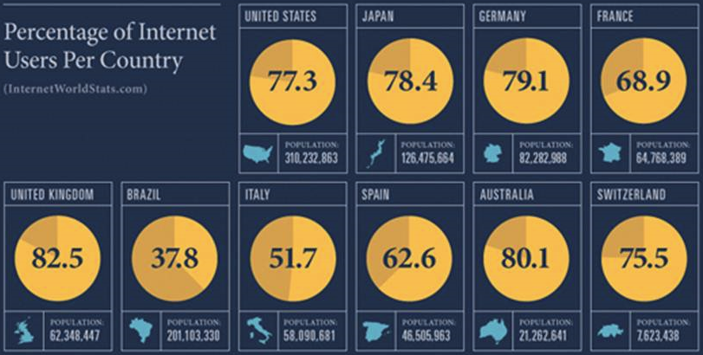
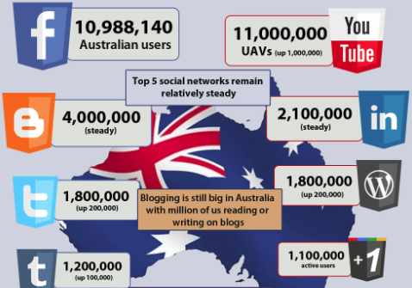
The Popularity of Online Social Networks
The popularity of OSNs has greatly increased in recent years
A large amount of Internet users also use OSN services,
Australia has up to 11 million Facebook users.

Slide 11
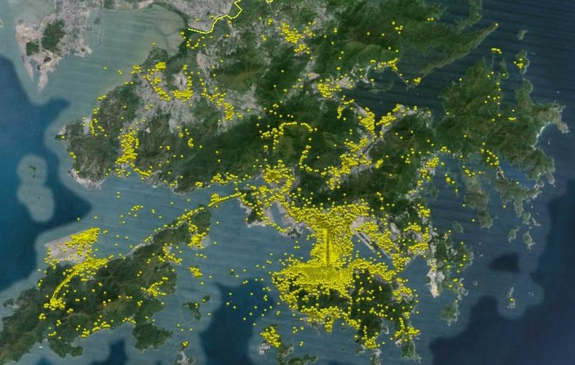

Application of Geo Photos
There are many geotagged photos available. However :
Data is noisy or misleading.
Photos are taken in transit rather than at the attractions.
Photo is static media, whereas, travel behavior is dynamic.
How to mine these data for travel behaviour analysis?

Slide 12
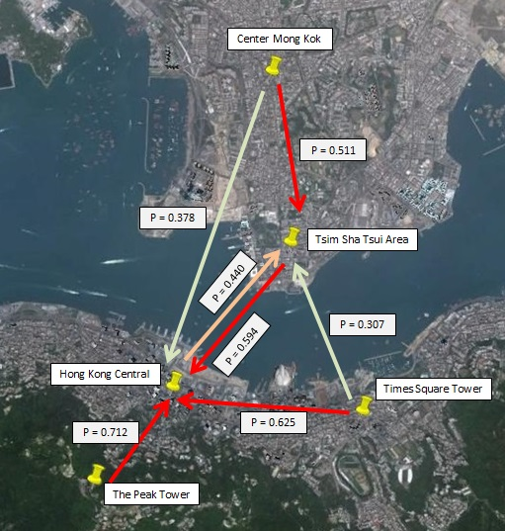
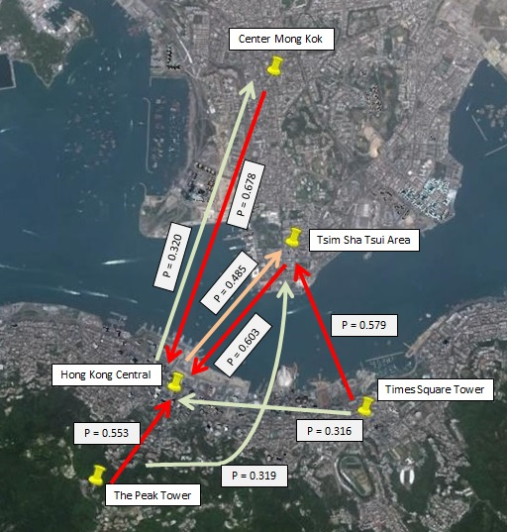
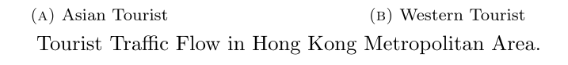
Tourist Movement Analysis
Notes:
Asian Tourists are likely to flow to Hong Kong central area from surrounding areas Tourist from Center Mong Kok tend to visit Tsim Sha Tsui as the next destination while, somes chose to travel directly to Hong Kong Central. Considerable tourist flow are found from Hong Kong Central and Times Square Towers to Tsim Sha Tsui
Western tourists tend to visit Hong Kong Central directly right after visiting Center Mong, while, somes travel in the opposite direction. Tourists are more likely to visit Tsim Sha Tsui than Hong Kong Central after visiting Times Square Towers. Some tourists visited Tsim Sha Tsui right after going to the Peak Tower.

Slide 13
Tourist Movement Analysis
Huy Quan Vu, Gang Li, Rob Law, Ben Haobin Yip. Exploring the travel behaviors of inbound tourists to Hong Kong using Geotagged photos. Tourism Management.

Slide 14
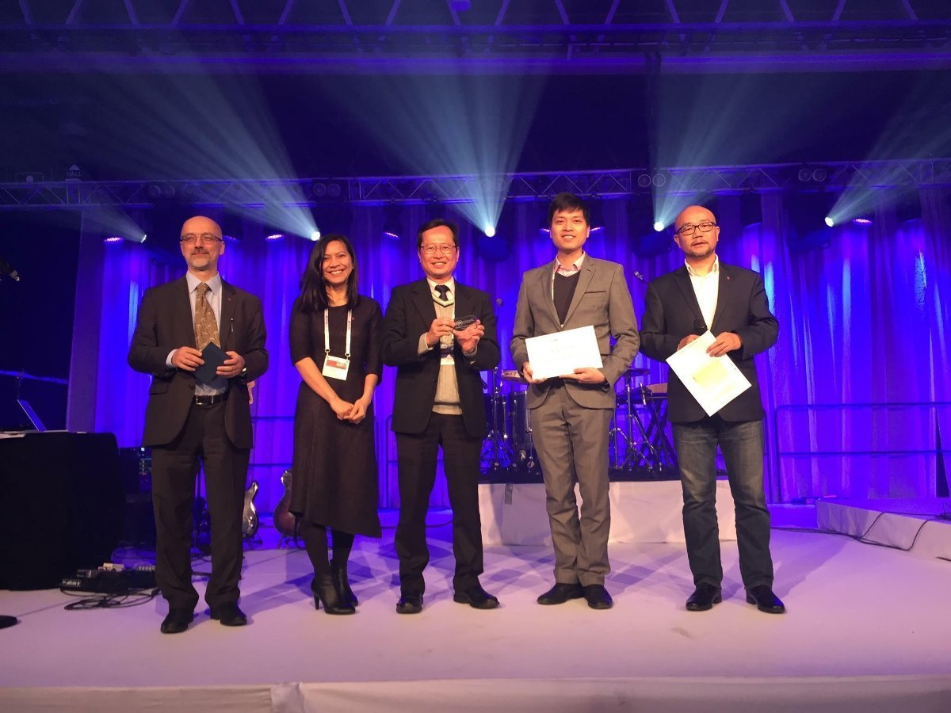
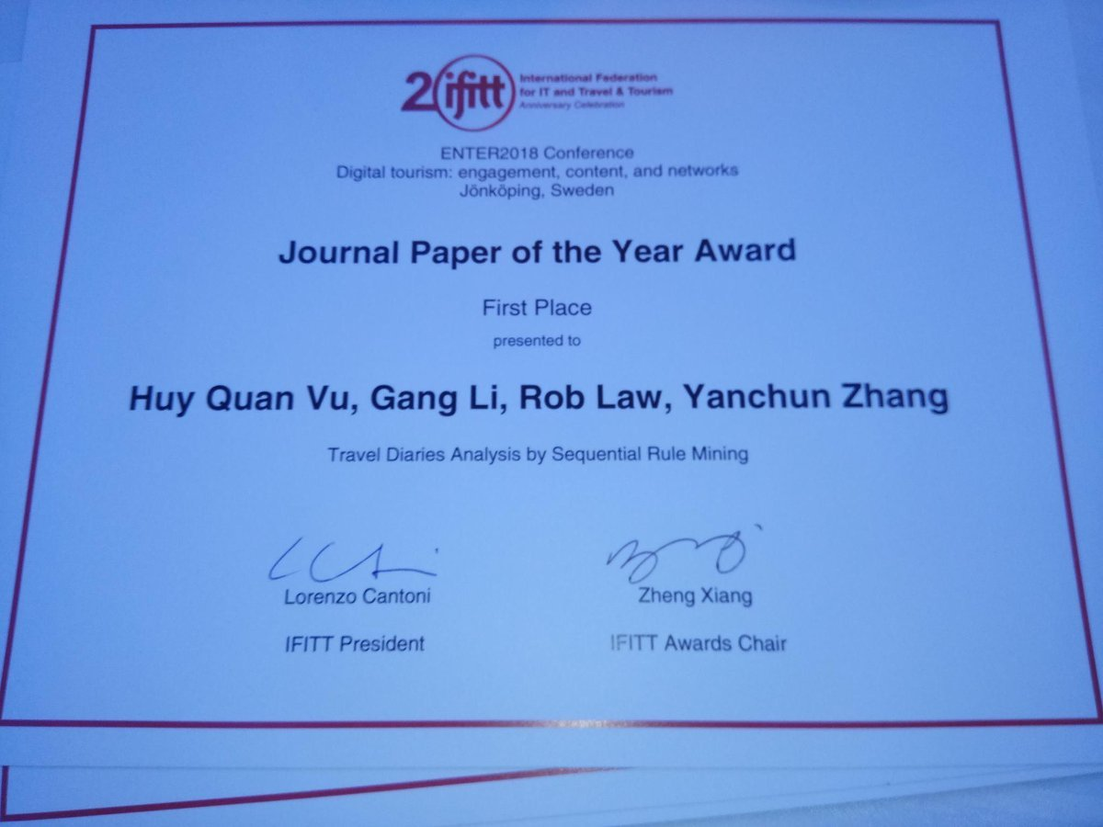
Tourist Movement Analysis

Slide 15
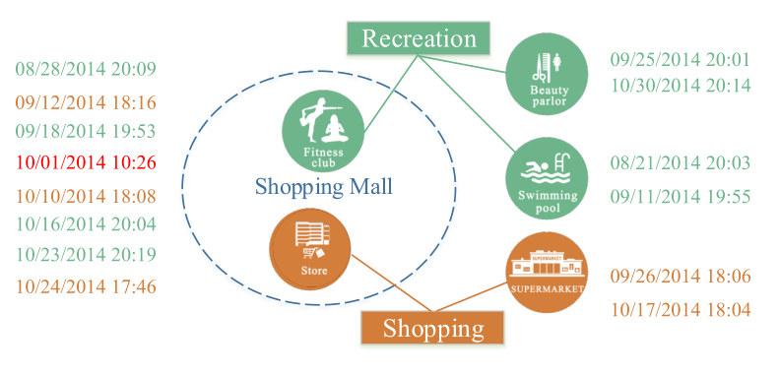
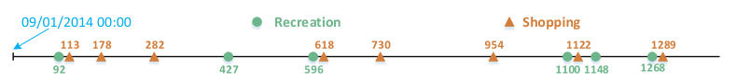
Periodic Behavior Mining
Observed Check-in Data is usually a mixed events from different periodic behaviors
What are Periodic?
What is the period?
Predict the Behavior on a particular day

Slide 16
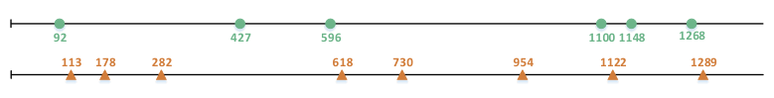
Periodic Behavior Mining
Observed Check-in Data is usually a mixed events from different periodic behaviors
What are Periodic?
What is the period?
Predict the Behavior on a particular day

Slide 17
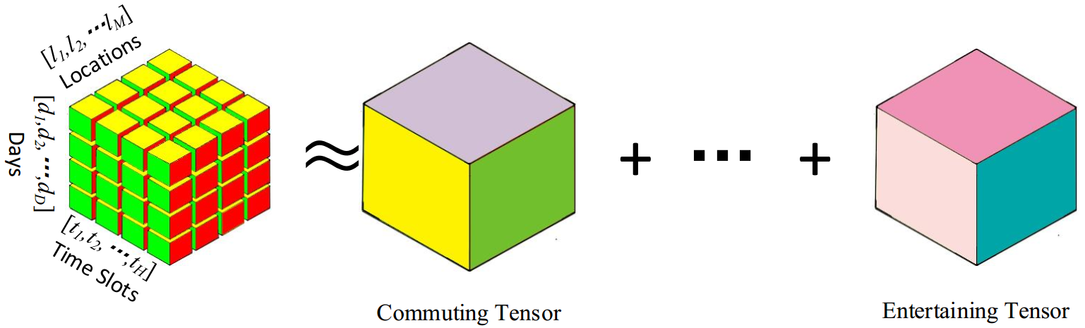
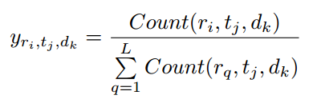


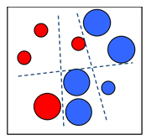











Periodic Behavior Mining Mobility Intentions
CP Decomposition
Users’ history records
Mobility Intention Sequence
… …
Mobility Intentions
…
… …
multi-class classifier

Slide 18
Periodic Behavior Mining Applications
There are various applications of Periodic Behavior Mining
What is the schedule of a person on a particular day/time?
Where to find the person on a particular day/time?
Police applications
Scheduled “Encountering” for match making
Timely Recommendation Systems
Now it is the time for you to stock rice, cooking oil, or ice cream!

Slide 19
Data Science Application (Case 1: Face Age Recognition)
Xin Geng, Zhi-Hua Zhou, Yu Zhang, Gang Li, Honghua Dai. Learning from facial aging patterns for automatic age estimation. Proceedings of the 14th annual ACM international conference on Multimedia, 2006

Slide 20
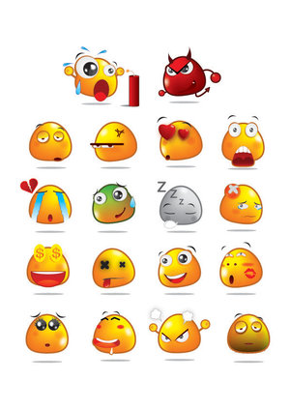

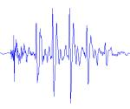
Data Science Application (Case 2: Speech-based Emotion Detection)
Jia Rong, Gang Li, Yi-Ping Phoebe Chen: Acoustic Feature Selection for Automatic Emotion Recognition from Speech. Information Processing and Management, 45(3): 315-328 2009

Slide 21
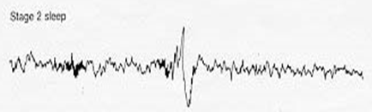
Data Science Application (Case 3: K-Complex Detection)
Sleep Stage Identification
Rapid Eye Movement (REM) Sleep
A normal stage of sleep characterized by the rapid movement of the eyes (is relatively easily discernible in PSG)
20%-25% of total sleep time in human adults, memorable dream
Non-REM Sleep
N1: slow eye movement, hypnic jerks at beginning, believe fully awake
N2: non eye movement, rare dreaming, easily awaken
N3: deep sleep, sometimes dreaming, but disconnected, less vivid
General sleep order in cycles of REM and NREM: N1 → N2 → N3 → N2 → REM
Early in the night, a greater amount of deep sleep (N3)
Later in the night, REM sleep increases, and before natural awakening
Vu, Quan; Li, Gang; Sukhorukova, Nadezda; Beliakov, Gleb; Liu, Shaowu; et al. K-complex Detection using a Hybrid-Synergic Machine Learning method. IEEE Transactions on SMC(C), PP(99): 1-13.

Slide 22
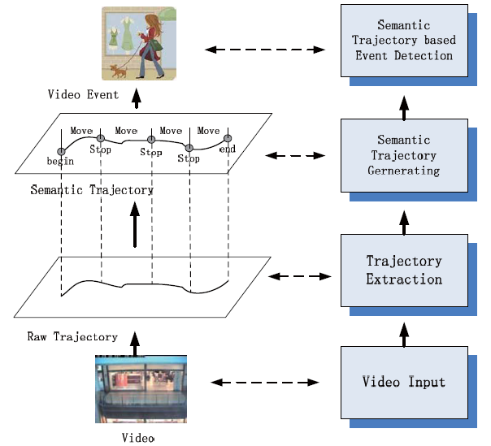
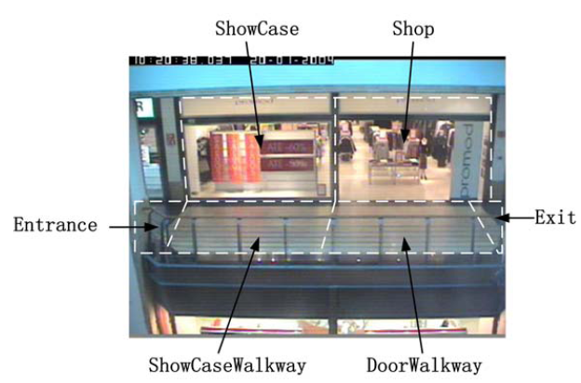
Data Science Application (Case 4: Trajectory Analysis)
Xiaofeng Wang, Gang Li, Guang Jiang, Zhongzhi Shi. Semantic Trajectory based Event Detection and Event Pattern Mining, Knowledge and Information Systems (KAIS), pp. 1-25, 2011.

Slide 23
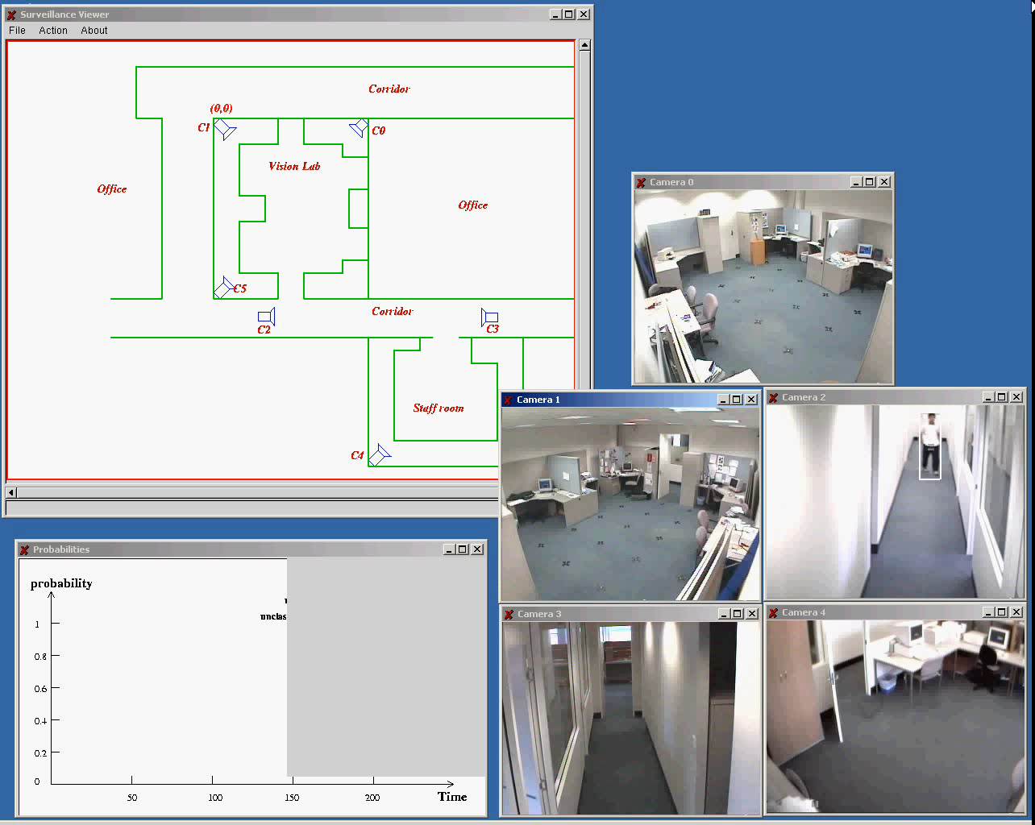
Data Science Application (Case 5: Video Surveillance)

Slide 24
Theme 2. Information Abuse Prevention
Information Abuse:
The compromise of information for which the data stakeholders are not willing to disclose.
It depends on the nature of the information, the involved internal or external users, and the ways in which the organization grants the access to or releases the information.

Slide 25
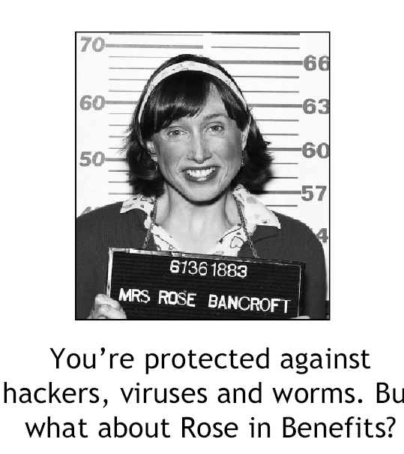
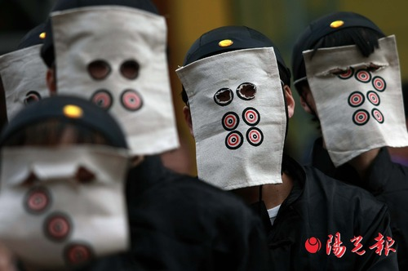
Who is an adversary?
Every user is potentially an adversary
After data is released, we cannot prevent any user from performing any type of analysis on the released data
Worst case scenario
Must account for disclosure risk from any and all types of analyses

Slide 26
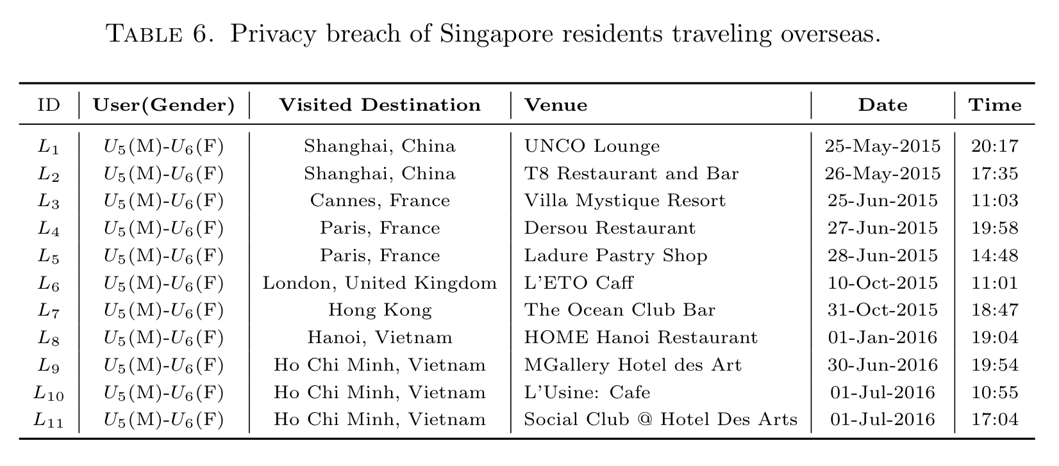
Information Privacy Applications (Case 1: Privacy Breach)
Huy Quan Vu, Gang Li, Rob Law, Yanchun Zhang. Tourist Activity Analysis by Leveraging Mobile Social Media Data. Journal of Travel Research, 2017.

Slide 27
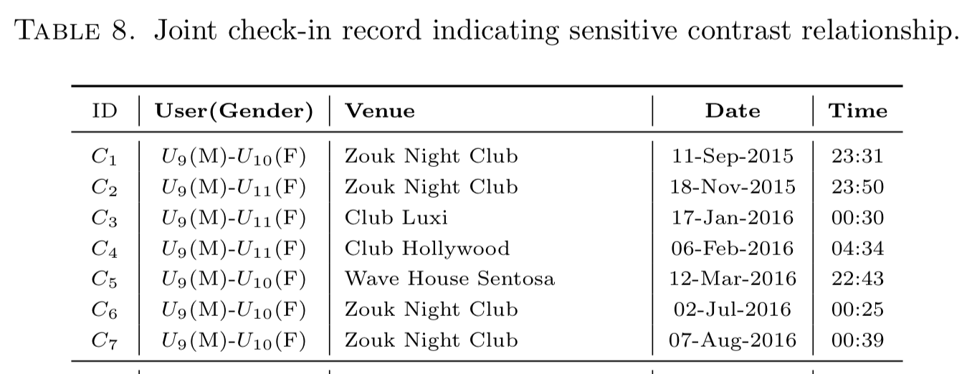
Information Privacy Applications (Case 2: Privacy Breach)
Huy Quan Vu, Gang Li, Rob Law, Yanchun Zhang. Tourist Activity Analysis by Leveraging Mobile Social Media Data. Journal of Travel Research, 2017.

Slide 28
Information Privacy Applications (Case 3: Is O.S.N. a secure place to show off?)
Tianqing Zhu, Gang Li, Wanlei Zhou, Ping Xiong, and Cao Yuan. Deferentially Private Tagging Recommendation Based on Topic Model. The 18th Pacific-Asia Conference on Knowledge Discovery and Data Mining (PAKDD), May 2014, Tainan, Taiwan.

Slide 29
Privacy Preserving Related Reference
Privacy Preserving in Data Releasing
T. Zhu, G. Li, W. Zhou, P.S. Yu. Differential Privacy and Its Applications: Survey, IEEE Transactions on Data and Knowledge Engineering, 2017
T. Zhu, G. Li, W. Zhou, P.S. Yu. Differential Privacy and Its Applications, Springer 2017
T. Zhu, P. Xiong, G. Li, W. Zhou. Correlated Differential Privacy: Hiding Information in Non-IID Dataset. IEEE Transactions on Information Forensics & Security, 2015, 10(2), 229-242

Slide 30
Theme 3. Business Intelligence
Tourism Data Mining
Tourist Behavior Analysis
Contrast Mining
Outlying Aspects Mining
Competitiveness Discovery
Recommendation System
group package recommendation
Heterogeneous Preferences

Slide 31
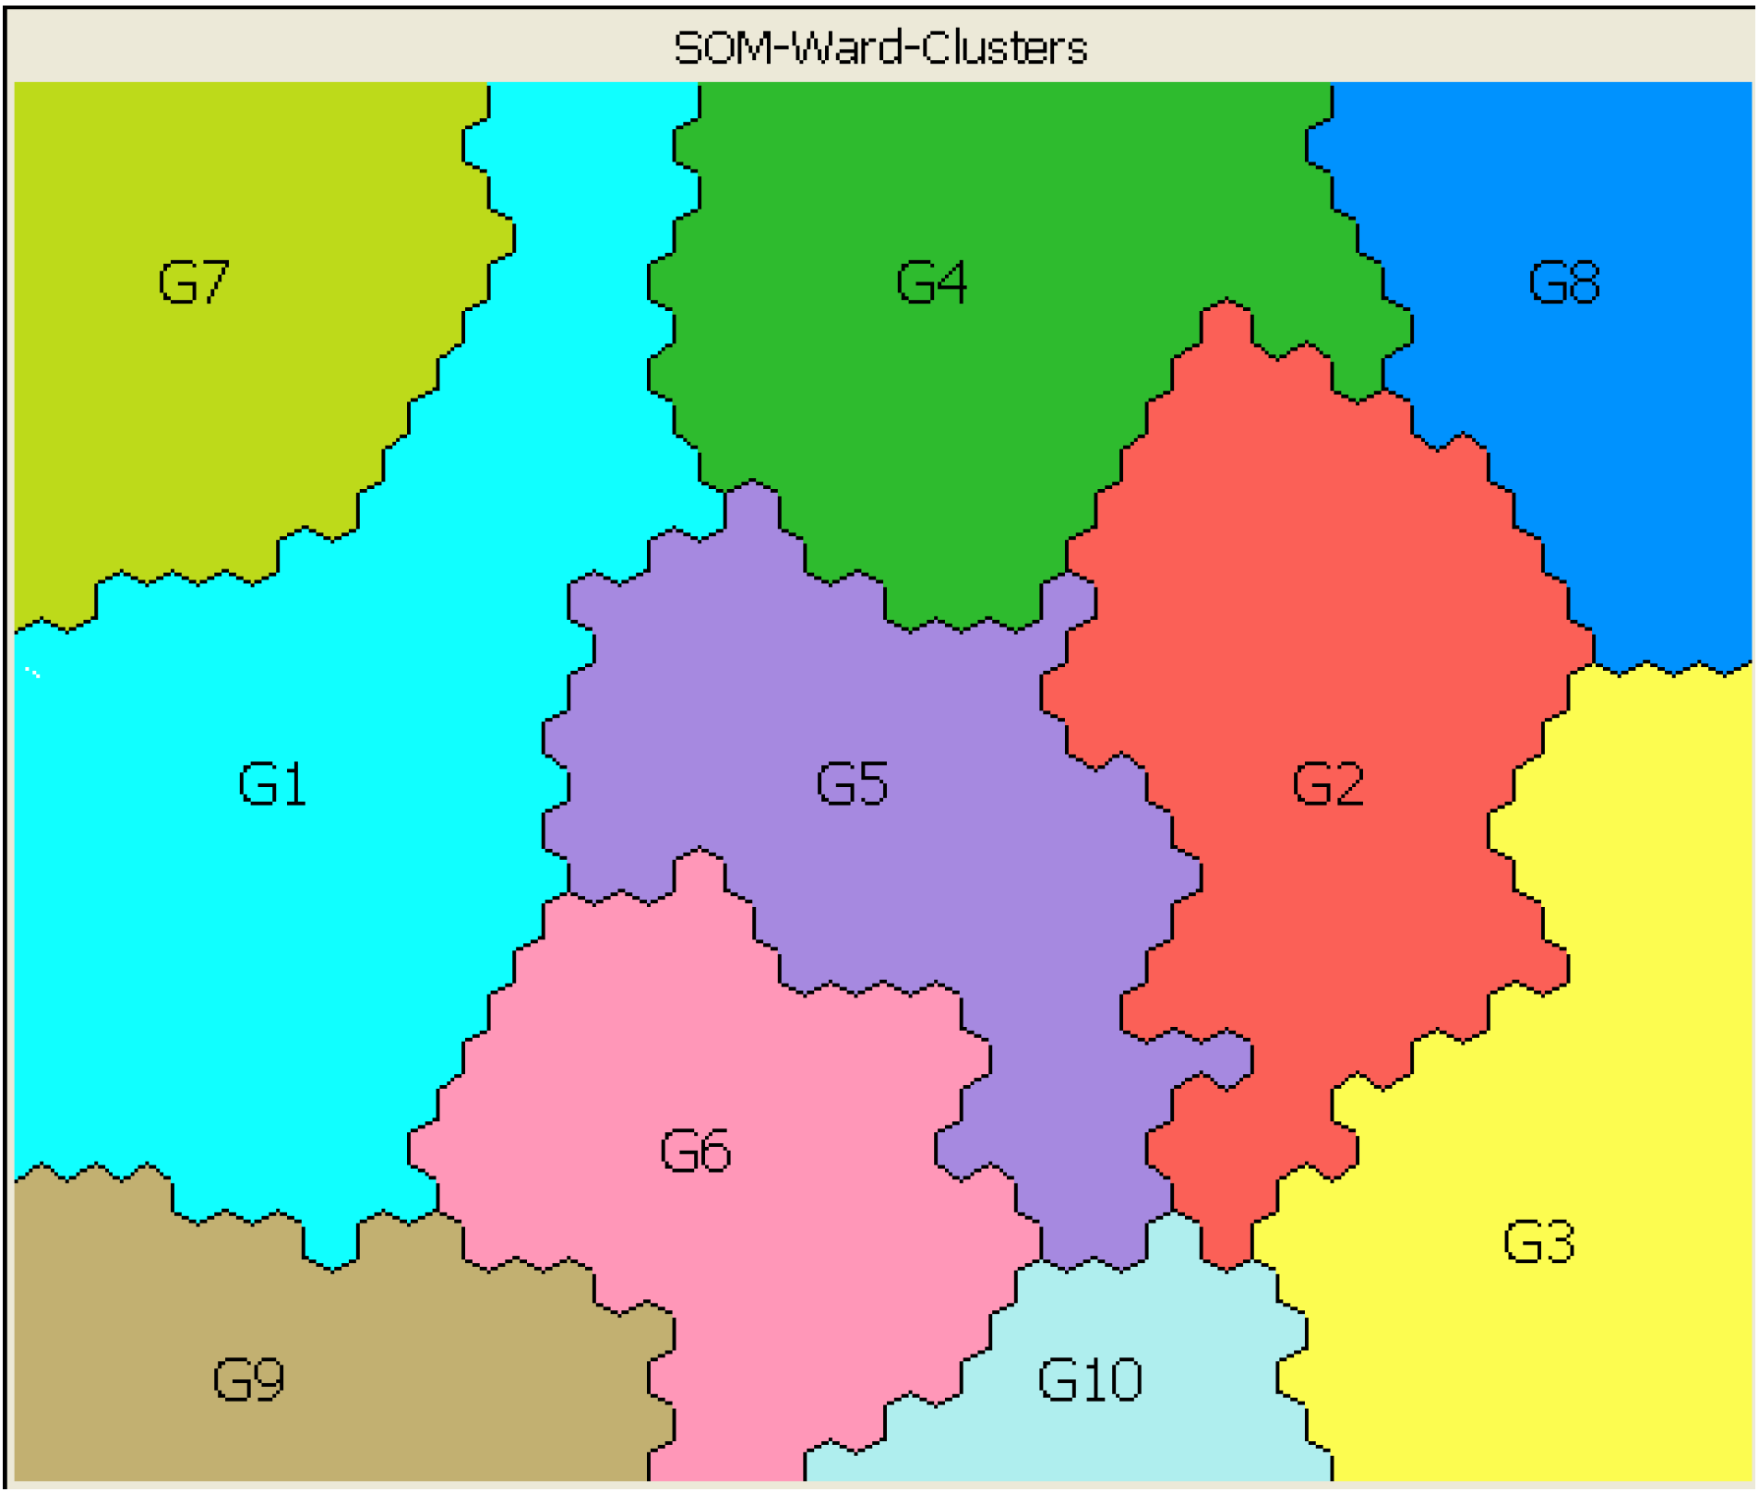
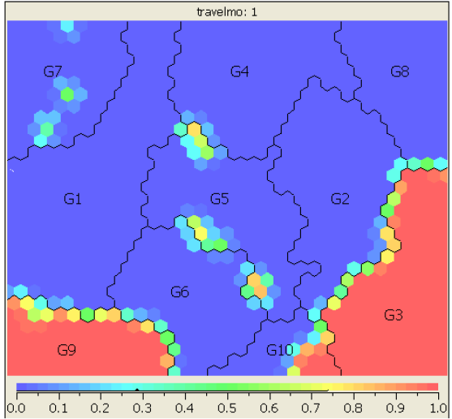
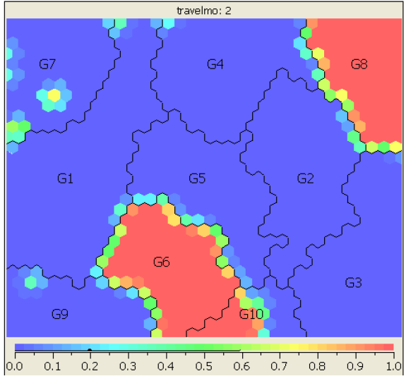
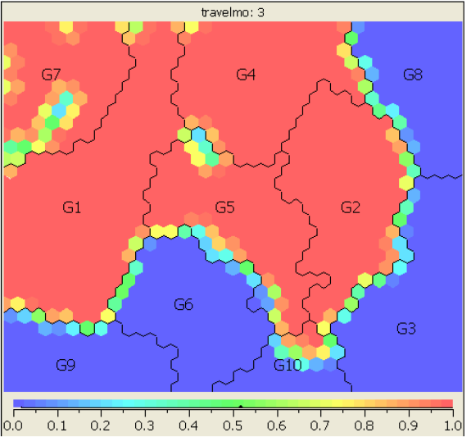
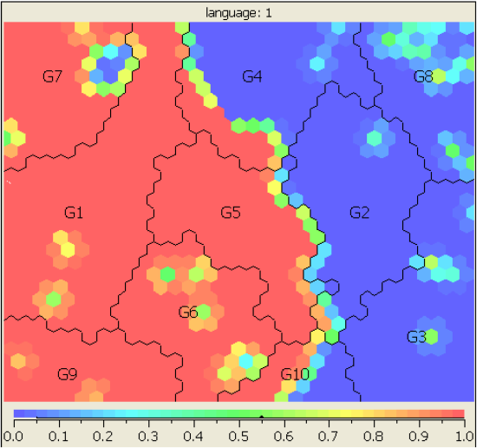
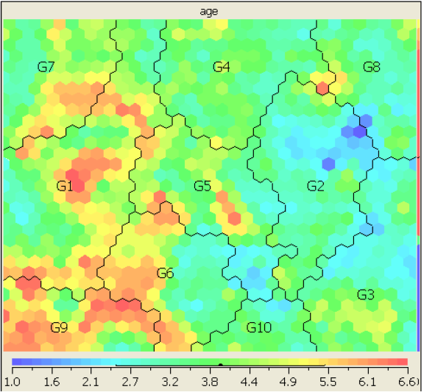
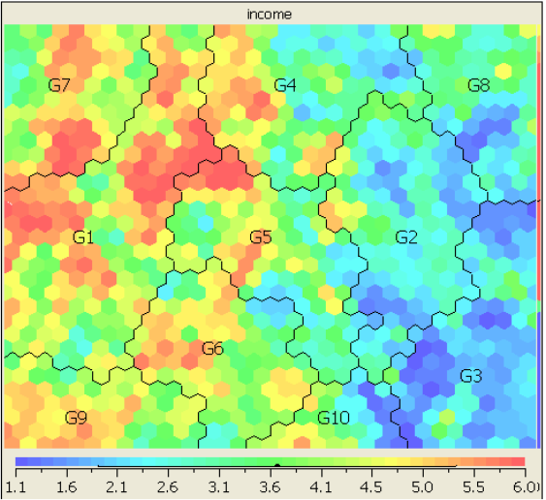
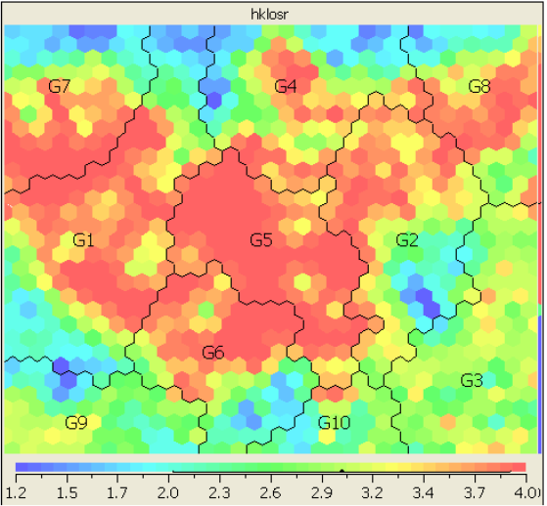
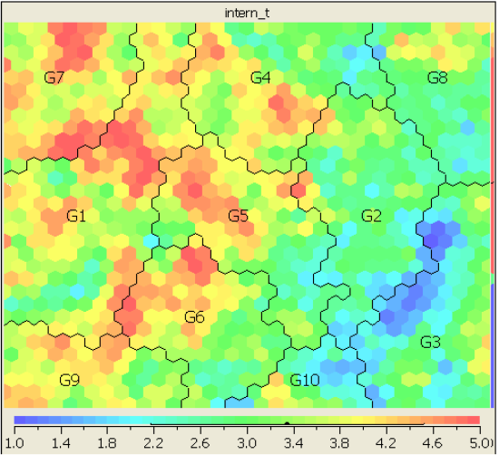
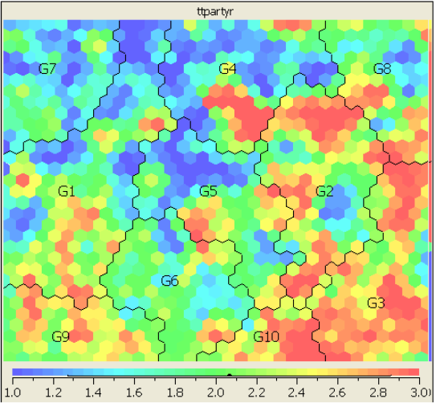
Business Intelligence Applications （Case 1: Market Segmentation Analysis）
Travel Mode: 1
Travel Mode: 2
partially packaged
Travel Mode: 3
Language: 1
Age
Income
HK Length of Stay
High income
Travel Experience
Travel Party
Low income
partially packaged
old
Fully packaged
Fully packaged
Gang Li, Rob Law, Jinlong Wang. Analyzing International Travelers' Profile with Self-Organizing Maps. Journal of travel & tourism marketing, 2010, 27(2): 113-131.
Notes:
Asian Tourists are likely to flow to Hong Kong central area from surrounding areas Tourist from Center Mong Kok tend to visit Tsim Sha Tsui as the next destination while, somes chose to travel directly to Hong Kong Central. Considerable tourist flow are found from Hong Kong Central and Times Square Towers to Tsim Sha Tsui
Western tourists tend to visit Hong Kong Central directly right after visiting Center Mong, while, somes travel in the opposite direction. Tourists are more likely to visit Tsim Sha Tsui than Hong Kong Central after visiting Times Square Towers. Some tourists visited Tsim Sha Tsui right after going to the Peak Tower.

Slide 32
Business Intelligence Applications (Case 2: Negative Association Rule Mining)
Transaction
Data
Sup(AUB) ≥ min_sup
lever(AUB) ≥ min_lever
Candidate Interesting Positive
Item-set
Generating Targeted
Item-set
Interesting Positive Item-set
User specified
Target Item
confi(A→~B) ≥ min_confi
Positive
Rules
Sup(AUB) < min_sup
Candidate Interesting Negative
Item-set
lever(AU~B) ≥ min_lever
confi(A→~B) ≥ min_confi
Interesting Negative Item-set
Negative
Rules
Reporting
Rules
Jia Rong, Huy Quan Vu, Rob Law, Gang Li. A Behavioral Analysis of Web Sharers and Browsers in Hong Kong using Targeted Association Rule Mining. Tourism Management, 2012, 33(4): 731-740.

Slide 33
Business Intelligence Applications (Case 3: Contrast Mining)
Contrast Targeted Rules Algorithm (CTR):
Detect the changes of rules strength between differences year data set.
Tracing the trend for predicting future potential.
2008
2010
V.S
?
A→B
A→B
?
A→B
A→B
2008
2009
2010
2011
…
Rosanna Leung, Jia Rong, Gang Li, Rob Law. Personality Differences and Hotel Web Design Study Using Targeted Positive and Negative Association Rule Mining. Journal of Hospitality Marketing & Management, 2013, 22(7): 701-727.

Slide 34
Business Intelligence Applications (Case 4: Heterogeneous Preferences)
User-wise biases
Users give lower ratings when in bad mood
Different scales, e.g., 4/5 star is “OK” for critics
User interface design
Item-wise biases
The same item presented differently, e.g., a movie in 3D, HD
Notes:
最后，用户的回馈信息可能是有偏差的。例如一个用户心情好的时候给一个本该是4分的商品打了2分。

Slide 35
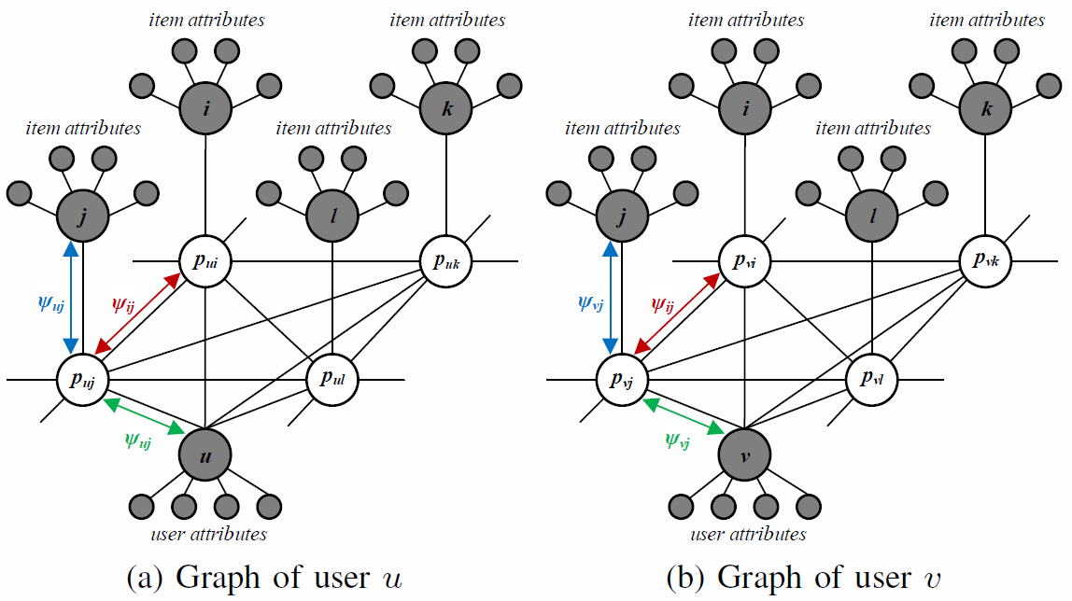
Business Intelligence Applications (Case 5: PR-based Conditional Random Fields)
Shaowu Liu, Gang Li, Truyen Tran, Yuan Jiang. Preference Relation-based Markov Random Fields. Asian Conference on Machine Learning (ACML), November, 2015, Hong Kong, China
Notes:
如此一来我们就会得到这样一个图模型。左右分别为用户u和用户v的图。其中p_ui这样的空心圆为用户偏好，而灰色的那些圆则是side information，例如用户信息和商品信息。
值得注意的是，红色的phi_ij在不同图中是一样的，对应的也是相同的weight。这个红色的phy_ij代表商品之间的互动（相似度），而这是矩阵分解没考虑到的一种信息。
图中蓝色的phi_uj考虑的是这个用户u喜欢什么类型的商品。
图中绿色的phi_uj考虑的是这个商品j被什么类型的用户喜欢。
两种信息整合在了phi_uj里，稍后（41页）会具体讲到。

Slide 36
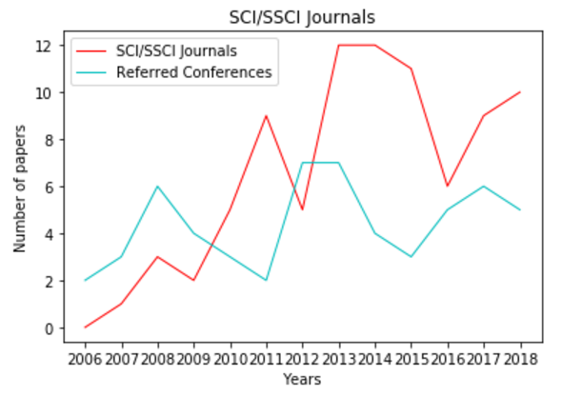
TULIP Lab Publications
Year | SCI/SSCI Journals |  |  | Referred Conferences
 | Q1 (71%) | Q2 (18%) | Q3 (11%) | A (16%) | B (9%) | C (75%)
2018 | 7 | 1 | 2 | 0 | 1 | 4
2017 | 6 | 2 | 1 | 0 | 0 | 6
2016 | 2 | 3 | 1 | 0 | 0 | 5
2015 | 6 | 4 | 1 | 0 | 1 | 2
2014 | 10 | 0 | 2 | 0 | 0 | 4
2013 | 11 | 1 | 0 | 3 | 2 | 2
2012 | 2 | 1 | 2 | 4 | 1 | 2
2011 | 7 | 1 | 1 | 0 | 0 | 2
2010 | 4 | 1 | 0 | 2 | 0 | 1
2009 | 1 | 1 | 0 | 0 | 0 | 4
2008 | 3 | 0 | 0 | 0 | 0 | 6
2007 | 1 | 0 | 0 | 0 | 0 | 3
2006 | 0 | 0 | 0 | 0 | 0 | 2
#Deakin is 211th in the World and TOP TEN in Australia.

Slide 37
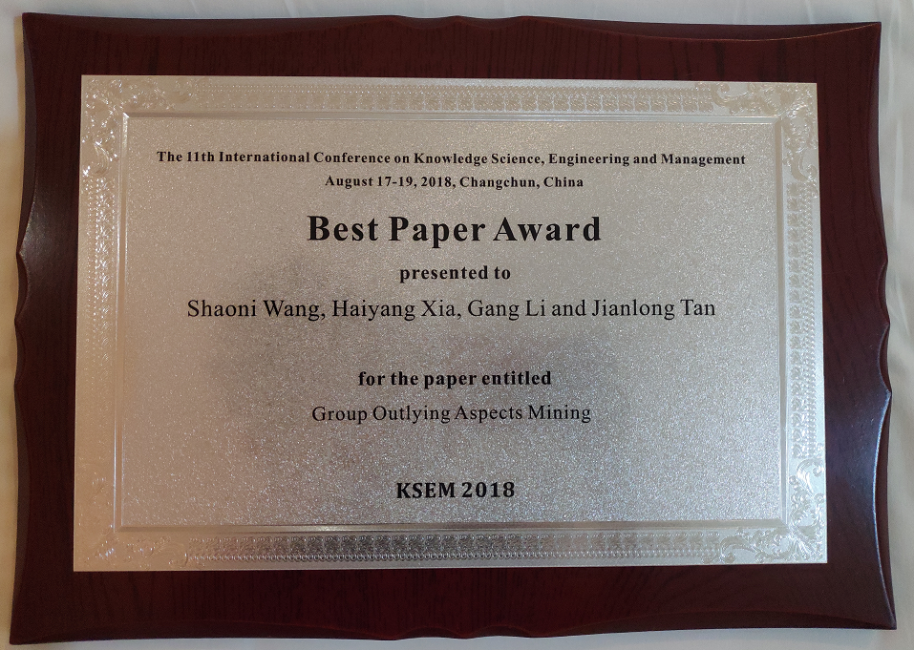
Awards
Year | Awards | Author
2018 2017 2016 2015 2014 2012 2007 | KSEM 2018 Best Paper Award IFITT Journal Paper of The Year Award (1st Prize) IEEE TrustCom 2016 Best Student Paper Award IFITT Journal Paper of The Year Award (3rd Prize) PAKDD 2014 Best Student Paper Award ACM ASONAM 2012 Best Paper Award MBEC 2007 Springer Nightingale Prize | Shaoni Wang Huy Quan Vu Na Pang Huy Quan Vu Tianqing Zhu Yongli Ren Jingyu Hou

Slide 38
Section Breaker

Slide 39
Training at TULIP (Team for Universal Learning and Intelligent Processing)
Professional knowledge
LaTeX, Version Control Systems (SmartGit GitHub Bitbucket)
Plan & Progress Review
References Management
Foundational Knowledge
FLIP (00) ~ FLIP (05)
Research Skills
Review Team
Reading Team
QQ Online
At least once a month
Read material before meeting, ask questions.
FLIP(00): Data Science
FLIP(01): Advanced Data Science
FLIP(02): Modern Data Science
FLIP(03): Deep Learning
FLIP(04): Learning Theory (I)
FLIP(05): Learning Theory (II)
Review Team
Reading Team

Slide 40
Training at TULIP (Team for Universal Learning and Intelligent Processing)
Learning content (FLIP00 ~ FLIP05)
Mathematics
Linear algebra, Probability theory, Mathematical statistics
Hands-on Skills
Python, Spark, Cloud platform
Learning theoretical knowledge
Optimization, Graph model
Professional knowledge
All of materials are English.

Slide 41
Aiming Higher...
TULIP Academy:
Complete FLIP(00)~ FLIP(01) with test on Kaggle Project
Read materials before TULIP Seminar and ask questions.
Learn LaTeX & PPR
Trainee:
Complete FLIP(02)~ FLIP(03) with Kaggle
Report in TULIP Seminar
SmartGit, Bitbucket and Mendeley
Infinity:
Meeting with Gang Leader twice a week (Research)
Complete FLIP(04)~FLIP(05)

Slide 42
Section Breaker

Slide 43
Regulations
TULIP Academy
You must not be absent from the meeting without permission.
Xi'an group members must attend the seminar in the Lab, and NOT online.
Collaborate with team members, rather than attacking each other.
FLIP Study
All FLIP students need to pass the corresponding prerequisite.
All FLIP materials are confidential, and you should not circulate it outside.
Research
SmartGit, Bitbucket, Mendeley, update PPR in time.
Actively discuss research work in the group meeting, and TULIP Seminar.
Everyone should prepare at least one question for each TULIP seminar.

Slide 44
Questions?

Slide 45
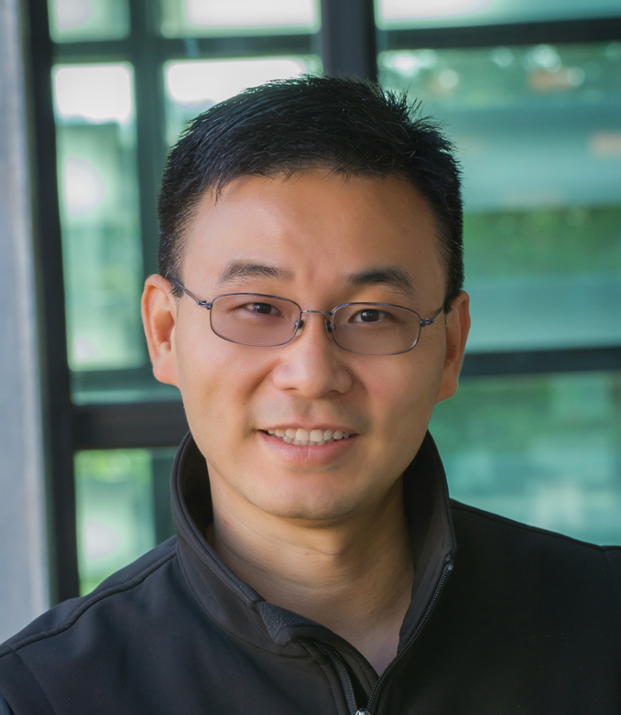
Contact
A/Prof. Gang Li
School of IT, Deakin University VIC 3125, Australia
gang.li@deakin.edu.au
Phone: +61(3)925-17434
Office: T207.WS14 (Burwood)

